Slide 1
Contextual Control of Derived Perspective Taking Using an Operant Relational Triangulation Perspective Taking Protocol
Paul M. Guinther, Ph.D.
Portland Psychotherapy
Portland, Oregon USA
pguinther@portlandpsychotherapyclinic.com
PPC Lab Meeting Version 5/27/2016
[for ACBS World Conference 2016, Seattle]

Slide 2
Research supported by:
Research Lab at Portland Psychotherapy
Portland Psychotherapy Internal Grant Program
2015 Aaron S. Luoma Portland Psychotherapy Behavioral Science Research Grant/Award
With thanks to:
Josh Kaplan, M.A.

Slide 3
Two Relational Frame Theory Perspectives on Perspective Taking
Deictic Pair Framework Barnes-Holmes, Barnes-Holmes, & Cullinan (2001)
According to the established RFT paradigm, perspective taking can be understood in terms of deictic relational frames.
The pertinent deictic relational frames include:
I-You, Here-There, and Now-Then
Relational Triangulation Framework Guinther (now)
A new alternative RFT paradigm that treats deictics differently.
The pertinent repertoire for perspective taking is:
Relational Triangulation

Slide 4
Deictic Pointing
Single Target
(no relation)

Slide 5
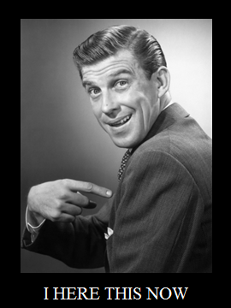
Deictic Pointing
Single Target
(no relation)
Single Target
(no relation)

Slide 6
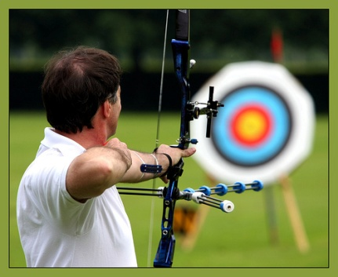
Deictic Pointing and Self as Context (having a spatiotemporal perspective)
The spatiotemporal origin of the pointing behavior exerts contextual control over the specification of a single target stimulus
SELF
Here
A
C
B

Slide 7
Deictic Relating and Self as Context (having a spatiotemporal perspective)
The spatiotemporal origin of the pointing behavior exerts contextual control over the specification of a target relative to another stimulus.
Where is the ball?
The ball is to the of the cup.
right
left
SELF

Slide 8
Deictics Aren’t Enough:
How do we get from having a deictic perspective…
“I think the ball is on the left.”
SELF

Slide 9
Deictics Aren’t Enough:
… to taking a deictic perspective?
OTHER
“You think the ball is on the right.”
SELF

Slide 10
Deictics Aren’t Enough:
… let alone taking a cognitive (self-as-content) perspective?
OTHER
“I prefer the cup,
but you prefer the ball.”
SELF

Slide 11
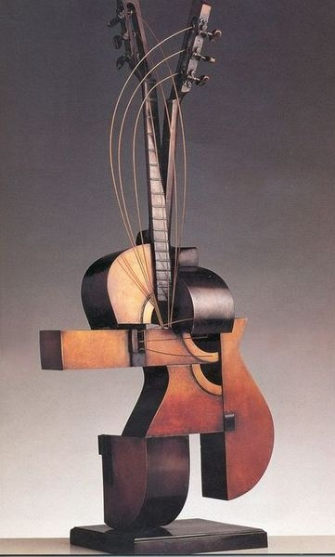
Relational Triangulation Framework
A new RFT explanation intended to account for deictic as well as non-deictic perspective taking.
OTHER
STIMULI
SELF

Slide 12
Relational Triangulation Framework
The spatiotemporal (context) and material (content) perspectives of others (people/objects/places/times) can be derived through the act of relational triangulation.
Any two sides of a relational triangle jointly entail the third
Self-Stimuli Bearings
Other-Stimuli Bearings
Self-Other bearings
OTHER
STIMULI
SELF

Slide 13
Spatial Deictic Relational Triangulation
OTHER
???
RELATA
???
→ Same (Singular Point)→
B is to the right of A
A
B
→ Same (Singular Point)→
A is to the left of B
SELF
OTHER
SELF

Slide 14
Spatial Deictic Relational Triangulation
OTHER
A is to the left of B
RELATA
B is to the right of A
→ Same (Singular Point)→
B is to the right of A
A
B
→ Same (Singular Point)→
A is to the left of B
SELF
OTHER
SELF

Slide 15
Spatial Deictic Relational Triangulation
OTHER
A is to the left of B
RELATA
B is to the right of A
→ Same (Singular Point)→
???
A
B
→ Same (Singular Point)→
???
SELF
OTHER
SELF

Slide 16
Spatial Deictic Relational Triangulation
OTHER
A is to the left of B
RELATA
B is to the right of A
→ Same (Singular Point)→
B is to the right of A
A
B
→ Same (Singular Point)→
A is to the left of B
SELF
OTHER
SELF

Slide 17
Spatial Deictic Relational Triangulation
OTHER
A is to the left of B
RELATA
B is to the right of A
→ ???→
B is to the right of A
A
B
→ ???→
A is to the left of B
SELF
OTHER
SELF

Slide 18
Spatial Deictic Relational Triangulation
OTHER
A is to the left of B
RELATA
B is to the right of A
→ Same (Singular Point)→
B is to the right of A
A
B
→ Same (Singular Point)→
A is to the left of B
SELF
OTHER
SELF

Slide 19
Spatial Deictic Relational Triangulation
OTHER
A is behind B
RELATA
B is in front of A
???
→ ???→
???
B is to the right of A
???
A
B
→ ???→
A is to the left of B
SELF
SELF

Slide 20
Spatial Deictic Relational Triangulation
OTHER
A is behind B
RELATA
B is in front of A
→ Ahead on left, oriented right →
B is to the right of A
A
B
OTHER
→ Ahead on right, oriented left →
A is to the left of B
SELF
SELF

Slide 21
Spatial Deictic Relational Triangulation
OTHER
A is to the right of B
RELATA
B to the left of A
OTHER
→ Across facing opposite →
B is to the right of A
A
B
→ Across facing opposite →
A is to the left of B
SELF
SELF

Slide 22
Spatial Deictic Relational Triangulation
OTHER
A is in front of B
RELATA
B is behind A
→ Ahead on right, oriented left→
B is to the right of A
OTHER
A
B
→ Ahead on left, oriented right→
A is to the left of B
SELF
SELF

Slide 23
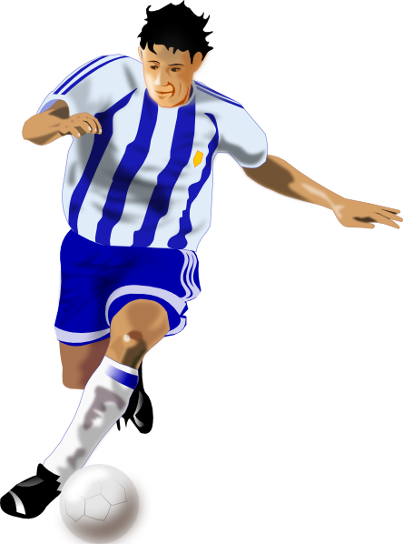
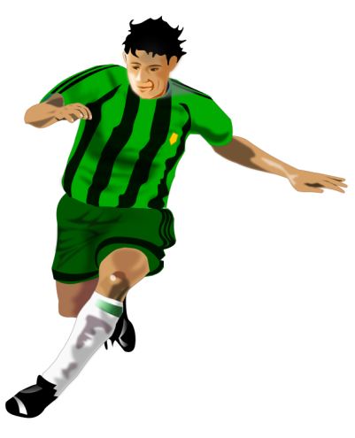
Material (Non-Deictic) Relational Triangulation through Social Role
The self is playing competitive soccer and scores a goal.
The self feels really good and wants to give high fives.
How does the other feel?
What does the other want to do?

Slide 24
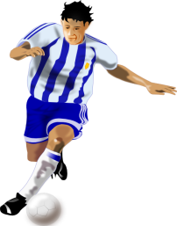
Material (Non-Deictic) Relational Triangulation through Social Role
OTHER
S^{D} High Five
STIMULI
OTHER
S∆ High Five
STIMULI
☺
☹
☺
☺
→ Teammate →
→ Opponent→
→ Teammate →
S^{D} High Five
→ Opponent →
S^{D} High Five
SELF
SELF
(Same) (Opposite)

Slide 25
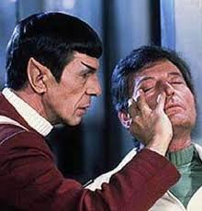
Relational Triangulation Framework
Main goals of current line of research:
Bring perspective taking under contextual control
Spatial
Your context to their context
Material (Cognitive)
Your content to their content
Do it in a way that clearly demonstrates derived relational responding

Slide 26
Relational Triangulation Perspective Taking Protocol (RT-PTP)
A match-to-sample procedure meant to be reconfigured for different purposes.
Participants
Community sample
Verbally Competent Adults
3 males and 4 females
26.71 (SD = 2.98) Mean Years of Age
14.43 (SD = 1.99) Mean Years Education

Slide 27
RT-PTP Levels 1 & 2 Matching Context to Avatar
Contextual Stimuli
Shapes X2 and X3
Conditional Stimuli
Avatars A2 and A3
Discriminative Stimuli
Keys: A S D (left, middle, right position)
X2 X3
↓ ↓
A2 A3

Slide 28
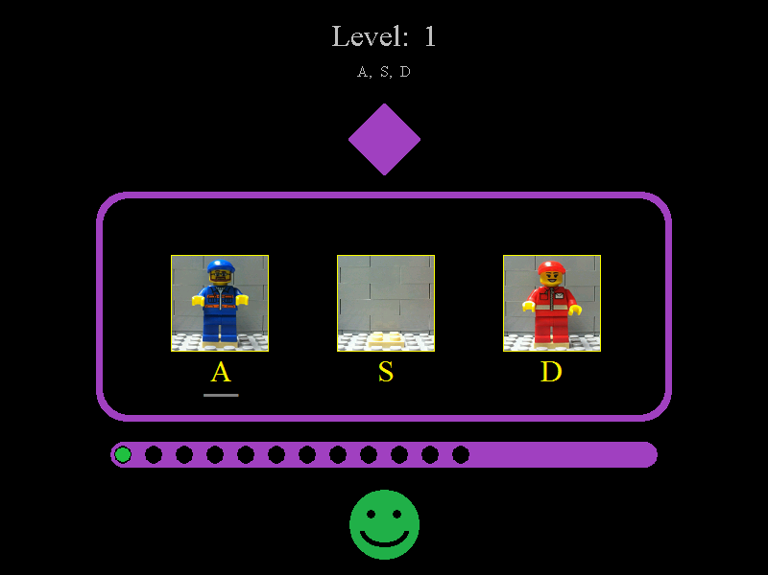

Slide 29
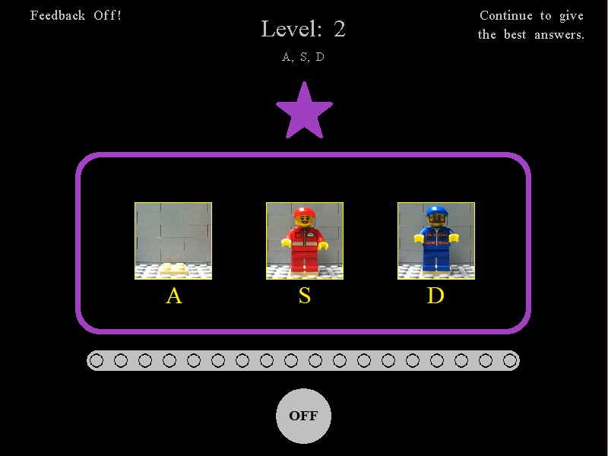

Slide 30
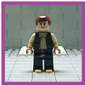
RT-PTP Levels 3 Simple Discrimination of Stimuli¹
Contextual Stimuli
Novel shape X1
For Self (A1)
Conditional Stimuli
Figure Identity
Stimuli¹
Discriminative Stimuli
Keys: Z X C
X1 X1 X1
↓ ↓ ↓
Luke Han Obi-Wan
Z X C

Slide 31
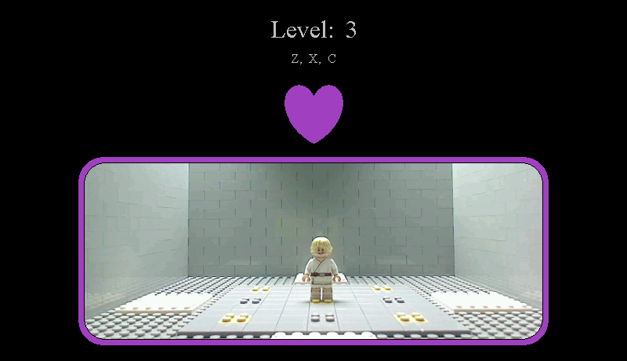

Slide 32
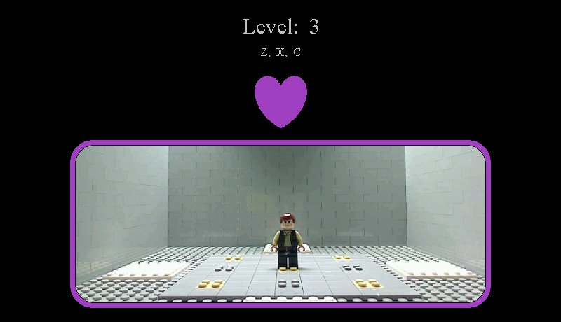

Slide 33
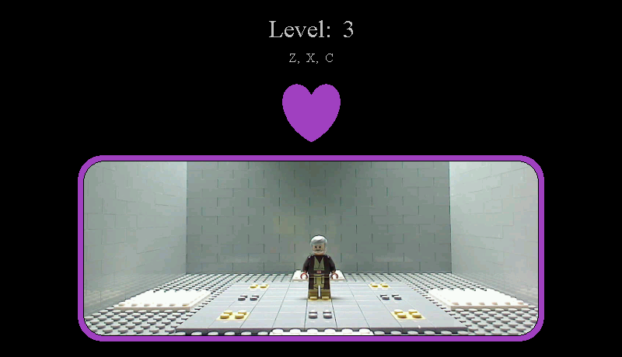

Slide 34
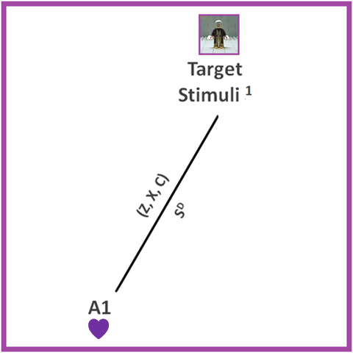
Level 3 Directly Trained Self-Stimuli¹ Bearings

Slide 35
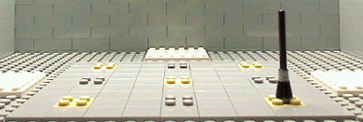
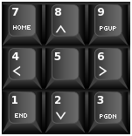
RT-PTP Levels 4-6 Directly Trained Deictic Pointing at Stimuli²
Contextual Stimuli
Shape X1
(A1^{DB} Deictic Bearings)
Conditional Stimuli
Beacon Location
Stimuli²
Discriminative Stimuli
Keys: 1-9
(left, middle, right X here, there, yonder)
(A1^{DB})
↓
Beacon at Locations 1-9

Slide 36
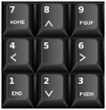

Slide 39
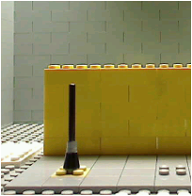
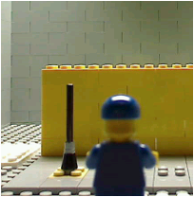
RT-PTP Levels 7-11 Many-to-one (Same) Deictic Pointing
Contextual Stimuli
Shape X1 and X2
(A1^{DB} Deictic Bearings)
(A2^{DB} Deictic Bearings)
Conditional Stimuli
Beacon Location
Stimuli²
Discriminative Stimuli
Keys: 1-3
(left, middle, right)
X1 X2
↓ ↓
Mound 1-3

Slide 41
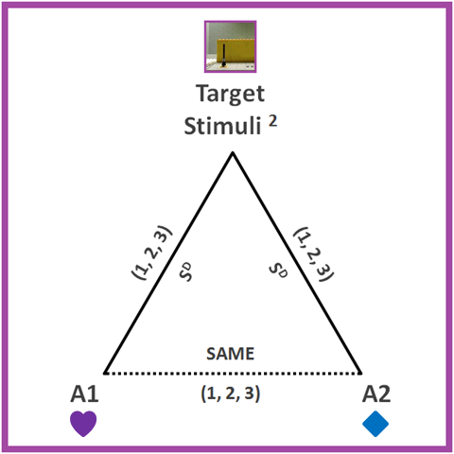
Directly Trained Self-Stimuli² and Other-Stimuli² Bearings

Slide 42
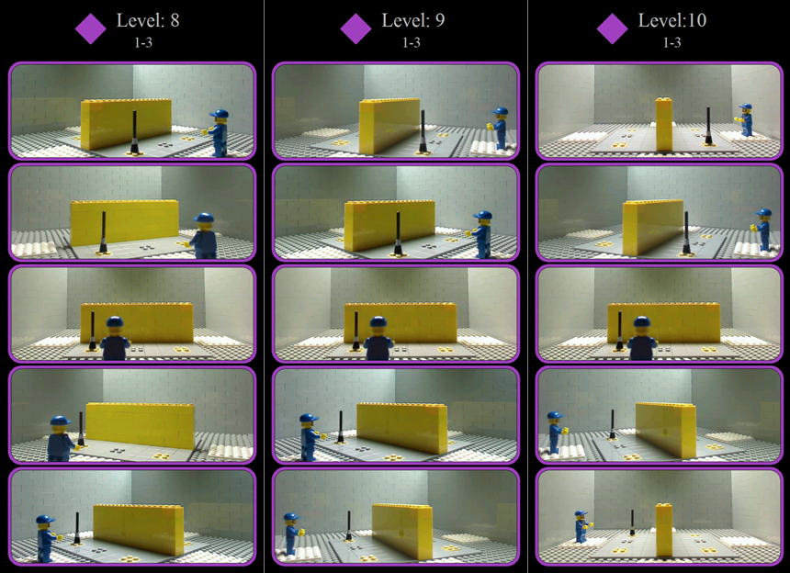

Slide 50
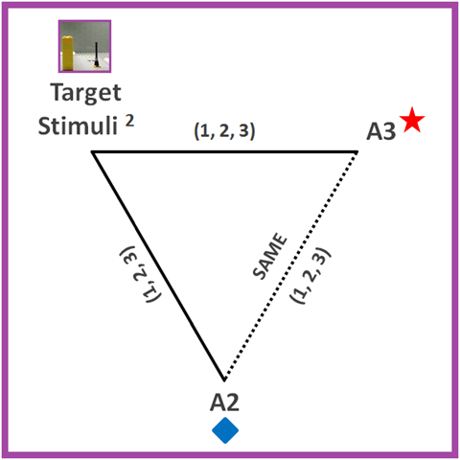
Directly Trained Other^{A2}-Stimuli² and Other^{A3}-Stimuli² Bearings

Slide 52
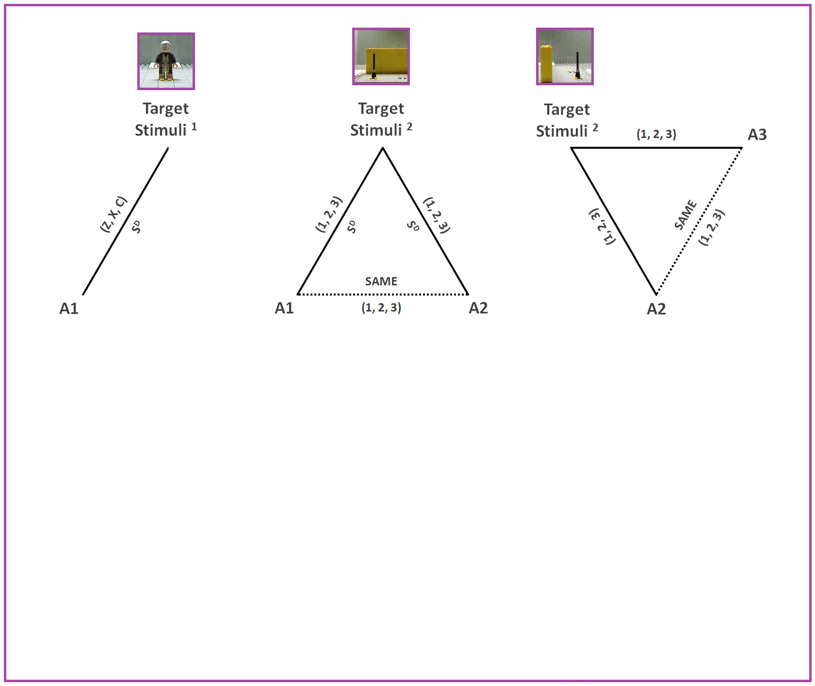

Slide 53
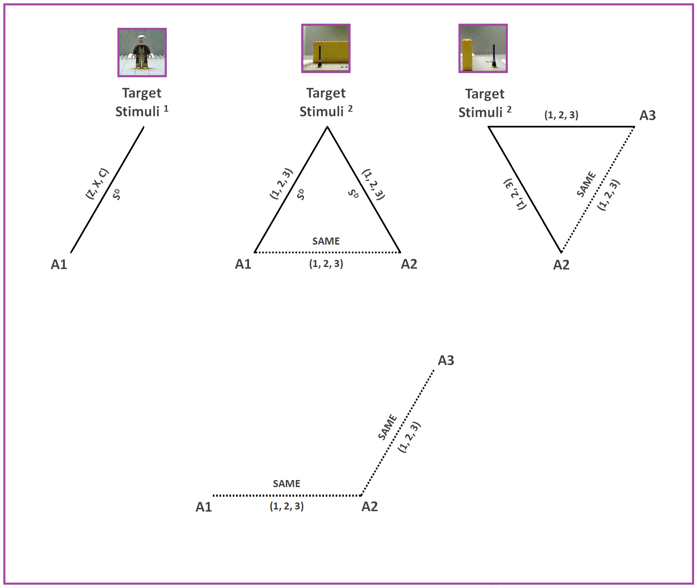

Slide 54
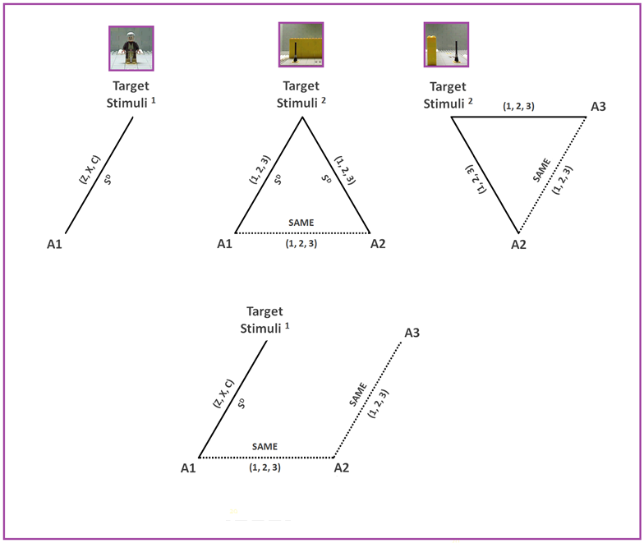

Slide 55
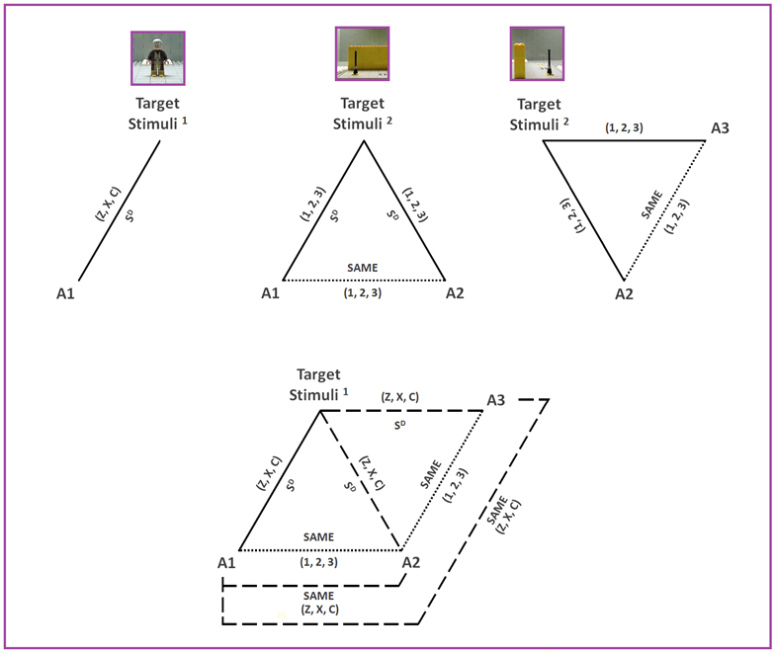

Slide 56
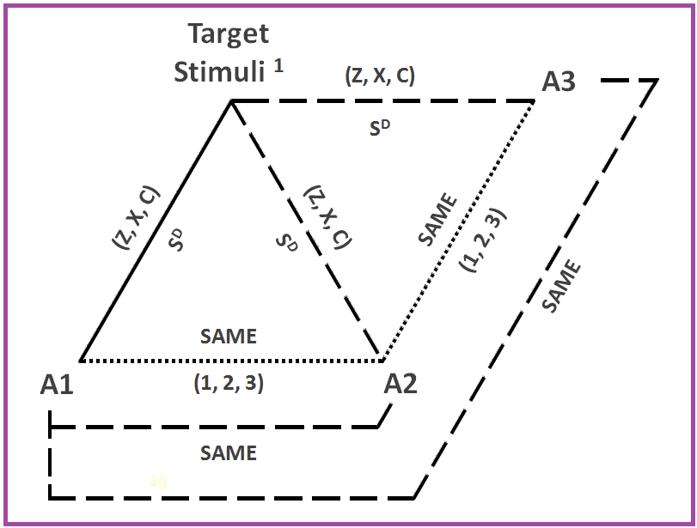
Test for Derived Perspective Taking

Slide 57
RT-PTP Individual Participant Data
 | Correct/Incorrect Trials
Level | P1 | P2 | P3 | P4 | P5 | P6 | P7
1 | 13/1 | 12/0 | 29/2 | 17/2 | 11/1 | 11/2 | 15/2
2 | 8/0 | 8/0 | 14/2 | 8/0 | 8/0 | 8/0 | 8/0
3 | 5/2 | 5/1 | 5/2 | 6/1 | 5/1 | 6/0 | 5/1
4 | 6/0 | 5/1 | 5/1 | 5/2 | 5/1 | 6/0 | 5/1
5 | 6/0 | 6/0 | 6/0 | 6/0 | 6/0 | 6/0 | 6/0
6 | 6/0 | 6/0 | 6/0 | 6/0 | 6/0 | 6/0 | 6/0
7 | 12/0 | 12/0 | 12/0 | 12/0 | 12/0 | 12/0 | 12/0
8 | 23/1 | 18/0 | 18/0 | 18/0 | 18/0 | 18/0 | 18/0
9 | 18/0 | 18/0 | 18/0 | 18/0 | 18/0 | 18/0 | 18/0
10 | 18/1 | 18/1 | 18/0 | 18/0 | 18/0 | 18/0 | 98/18
11 | 6/0 | 6/0 | 8/1 | 6/0 | 6/0 | 6/0 | 6/0
12 | 6/0 | 6/0 | 6/1 | 6/0 | 6/0 | 5/1 | 5/2
13 | 19/2 | 12/0 | 12/0 | 12/0 | 12/0 | 12/0 | 11/1
14 | 12/0 | 12/0 | 23/2 | 12/0 | 12/0 | 19/1 | 35/4
15 | 12/0 | 11/1 | 12/0 | 11/1 | 12/1 | 12/0 | 21/1
16 | 6/0 | 6/0 | 6/0 | 6/0 | 6/0 | 6/0 | 5/1
17 | 12/0 | 12/1 | 12/0 | 12/0 | 12/0 | 12/0 | 18/2
18 | 6/0 | 6/0 | 6/0 | 6/0 | 6/0 | 6/0 | 6/0
19 | 12/0 | 12/0 | 12/0 | 12/0 | 12/0 | 12/0 | 12/0
20 | 8/0 | 6/2 | 7/1 | 8/0 | 0/8 | 8/0 | 8/0

Slide 58
Potential Clinical Applications
CLIENT SELF CONCEPT
CLIENT
Judgmental
→ Same→
→ Same→
???
THERAPIST
Establishing bearings can help influence how clients think you view them

Slide 59
Potential Clinical Applications
CLIENT SELF CONCEPT
CLIENT SELF CONCEPT
CLIENT
Judgmental
CLIENT
Judgmental
→ Same→
→ ???→
→ Same→
???
→ ???→
Accepting
THERAPIST
THERAPIST
Establishing bearings can help influence how clients think you view them,
and influence your relationship.

Slide 60
Implications
Relational Triangulation Framework
An alternative to the established RFT account
But consistent with RFT and functional contextualism
Supported by a tightly controlled MTS procedure
Relational Triangulation Perspective Taking Protocol
That can generate new research questions
Basic and applied

Slide 61
Contact Paul Guinther, Ph.D.:
Portland Psychotherapy, OR USA
pguinther@portlandpsychotherapyclinic.com

